Slide 1

MAULANA AZAD NATIONAL INSTITUTE OF TECHNOLOGY, BHOPAL – 462003
Dept. Name- Mathematics ,Bioinformatics And Computer Applications
Topic-Epidemiological Modeling and Forecasting of India's First COVID-19 Wave Using SEIR and MLP Regressor
Done By:
Divy Pareek: 2240401121
Jay Gupta: 2240401107
Done Under:
Mrs. Usha Chouhan

Slide 2
Epidemiological Modeling and Forecasting of India's First COVID-19 Wave Using SEIR and MLP Regressor

Slide 3
Index
1. Key Objectives and Problem Statement Clearly define the motivation behind the study and the specific problem being addressed.
2. Terminology and Underlying Theory Introduce important terms, notations, and the theoretical foundations relevant to the project.
3. Project Overview and Workflow Diagram Present a high-level summary and the visual representation of the project's phases and interconnections.
4. Data Analysis, Filtering, and Preprocessing Work with real-world COVID-19 datasets to clean, preprocess, and prepare the data for modeling.
5. Mathematical Modeling: SEIR Model Implementation on Synthetic Data Develop and simulate the SEIR epidemiological model using synthetic datasets.
6. Validation on Real-World COVID-19 Dataset
Compare the SEIR model outputs with real pandemic data to validate its performance.
7. Machine Learning Forecasting Using Synthetic Data Train an MLP regressor to forecast future states based on SEIR-generated synthetic data.

Slide 4
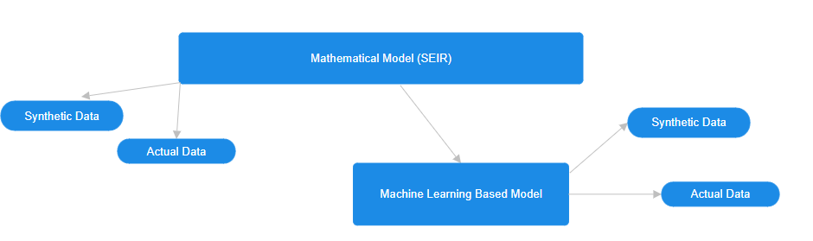
8. Validation Using MLP Forecasting Evaluate the accuracy of the ML model by comparing forecasts to actual observed data.
9. Performance Evaluation and Analysis Assess the effectiveness of both the SEIR mathematical model and the machine learning forecasts through quantitative metrics and visual comparisons.
10. Conclusion and Final Statement

Slide 5
Key Objectives and Problem Statement
Epidemiology is the branch of science that studies spread of the disease, its causes ,patterns of health and illness along with risk factors and preventive measures.
It forms the backbone of public health decisions, like planning vaccination drives , managing outbreaks (like COVID-19), or predicting future disease trends.
The SEIR (Susceptible–Exposed–Infectious–Recovered Model) model is a type of compartmental mathematical model used in epidemiology to simulate how a disease spreads through a population over time.
The model classifies the population in the following classes -
S (Susceptible): Individuals who are at risk of contracting the disease.
E (Exposed): Individuals who have been infected but are not yet infectious (they are in an incubation period).
I (Infectious): Individuals who are infected and can transmit the disease to susceptible individuals.
R (Recovered): Individuals who have recovered from the disease and are assumed to have immunity.

Slide 6
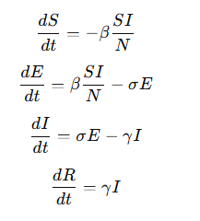

SEIR(Susceptible–Exposed–Infectious–Recovered Model) Mathematical model
Transitions between these compartments are modeled using differential equations based on parameters like:
β (beta): Transmission rate
σ (sigma): Rate of progression from exposed to infectious (1/incubation period)
γ (gamma): Recovery rate (1/infectious period)
https://medium.com/pythoneers/mastering-the-seir-model-a-comprehensive-guide-with-python-code-and-real-world-applications-da7584a4fb23
https://arxiv.org/pdf/2002.06563.pdf

Slide 7
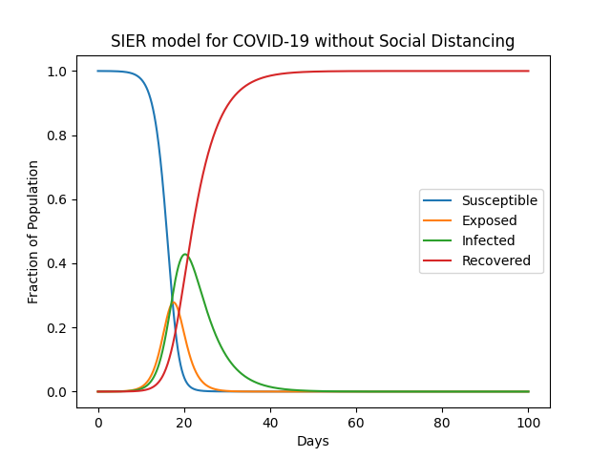
Implementing the mathematical model using synthetic data
Initial parameters:
sigma=0.2
gamma=0.5
beta=1.75
N (initial population)=10000
Total time frame = 100 days
t=0.1*T

Slide 8
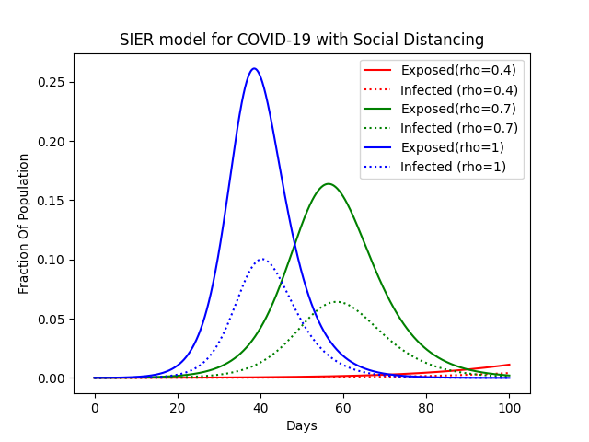
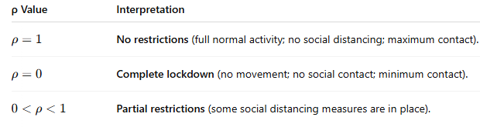
Introducing a new parameter (rho)
ρ (rho) represents the degree of social activity (or mobility) in the population.
It modulates how much people are interacting (and thus how much the disease can spread).

Slide 9
Implementation of the mathematical model (SEIR) on a real-time dataset
Step-1 : Define the Mathematical Model and get the time series data
Sources:
Johns Hopkins University (Link: https://github.com/CSSEGISandData/COVID-19)
Our World In Data
Government Health Portals
Data Needed:
Confirmed Cases
Recovered Cases
Deaths

Slide 10
Step:3 Preprocessing the missing values
Handle missing values
Convert cumulative counts to daily counts
Set initial values S(0),E(0),I(0),R(0)
Step:4 Parameter Estimation and Fitting the curve
Parameters to Estimate:
Transmission rate (β) : Due to changing transmission behavior of our disease, we have taken 4 initial values of beta (0.3,25,0.2,0.15)
Incubation rate (σ):Initial value (1/5.2)
Recovery rate (γ) (1/10)
Methods:
Literature values
Optimization fitting (e.g., least squares)

Slide 11
Step 6: Compare with Real Data
Visualization:
Plot predicted vs actual cases
Metrics like Mean Squared Error (MSE)
Goal:
Validate model performance
Step 5:Solve the Model
Numerical Method:
Solve ODEs using (scipy.integrate.odeint)
Initial Setup:
Population N
Initial Conditions (S0,E0,I0,R0)
Time vector

Slide 12
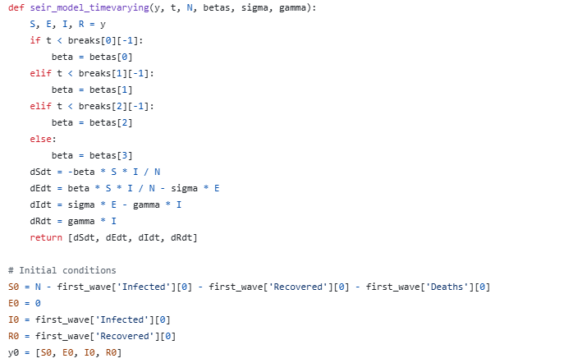
Code Excerpt

Slide 13
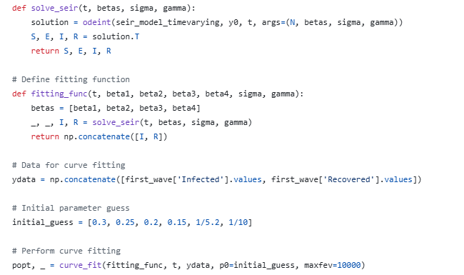

Slide 14
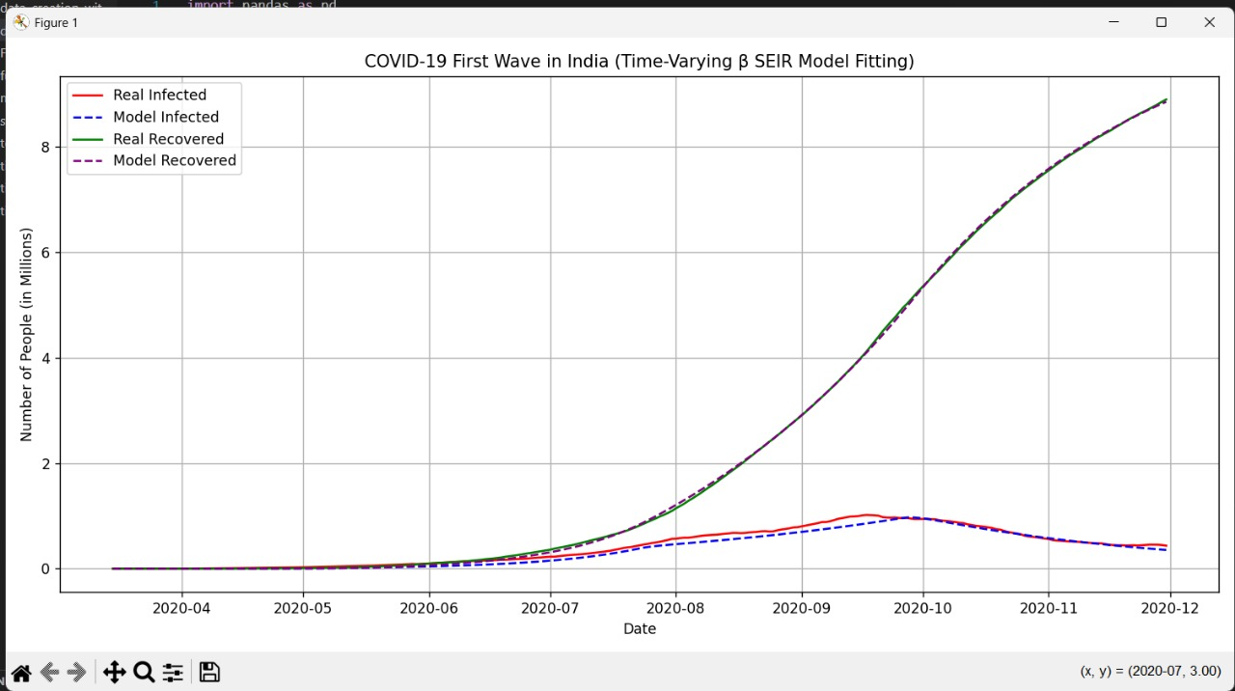
OUTPUT

Slide 15
Now, the data which we got from the mathematical model is used as a training data for our machine learning model for further future forecasting
Firstly, we will start with the synthetic data
The code runs a synthetic SEIR model for different parameter sets (beta, sigma, gamma) to simulate COVID-19 spread. It generates sequences of past and future data points, which are used to train a Multi-layer Perceptron (MLP) neural network for forecasting. The model is trained with 80% of the data and tested with 20%. Predictions for future cases (Infected, Recovered, etc.) are made using the trained model. The results are then compared visually with the true SEIR model outputs to evaluate the prediction accuracy.

Slide 16
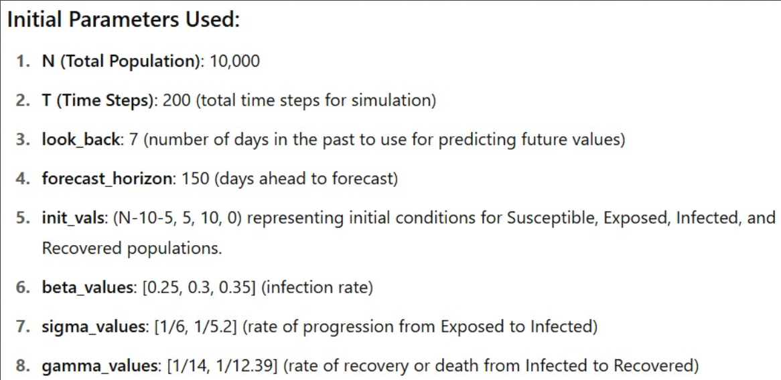

Slide 17
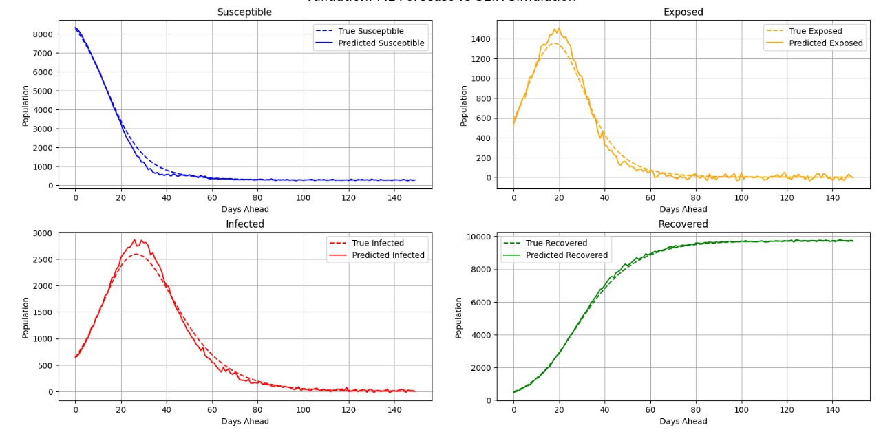

Slide 18
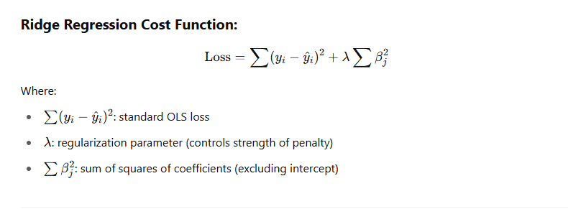

Slide 19
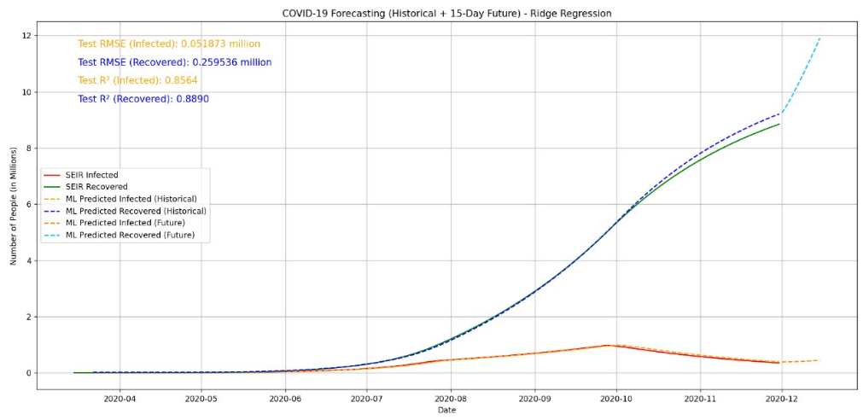
Now, training with data obtained from mathematical model (real-time Covid-19 data) we get the output

Slide 20
Acknowledgements:
Repository Link: https://github.com/jay9399/seir_model-
Dataset Links: https://github.com/CSSEGISandData/COVID-19
owner : Johns Hopkins University Center for Systems Science and Engineering (JHU CSSE)
Referenced research papers:
Epidemic analysis of COVID-19 in China by dynamical modeling
https://arxiv.org/pdf/2002.06563.pdf
https://www.thelancet.com/journals/langlo/article/PIIS2214-109X(20)30074-7/fulltext
Other Repositories and webpages:
https://github.com/DanielDaCosta/COVID-19-Analysis/blob/master/README.md
Various articles on SEIR modelling on medium.com and Wikipedia.org

Slide 21
Thank You

